Slide 1


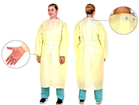

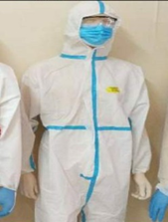
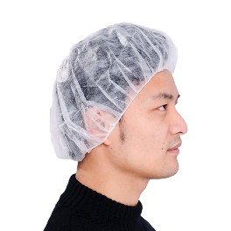
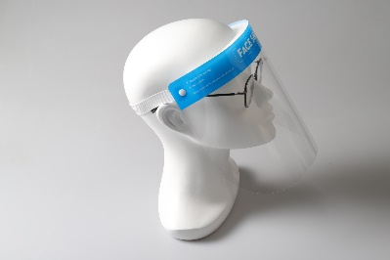
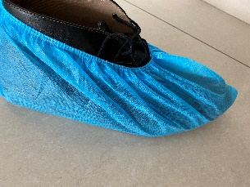
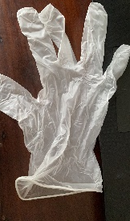
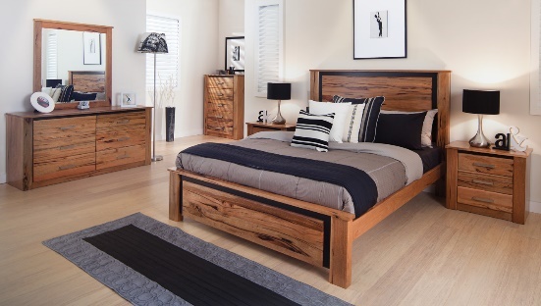
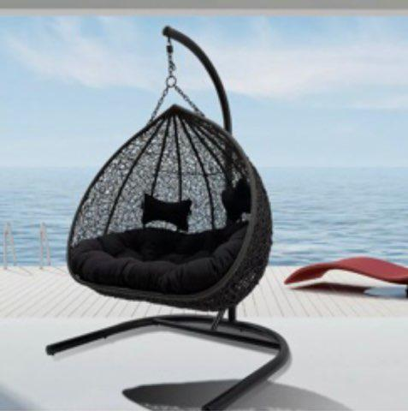
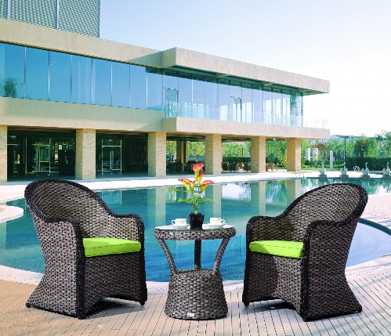
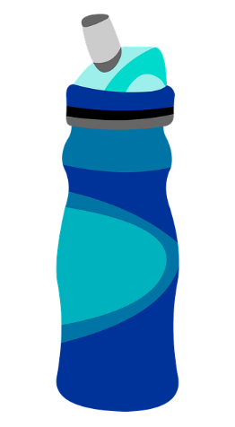
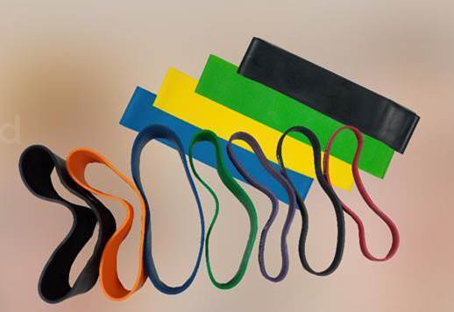
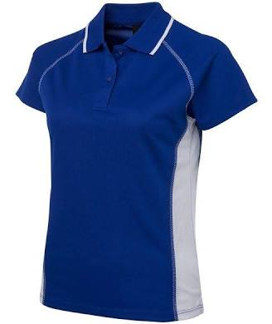
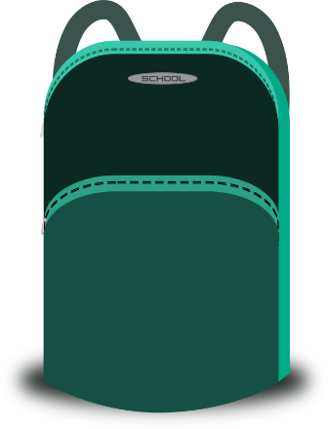
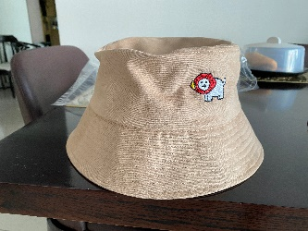
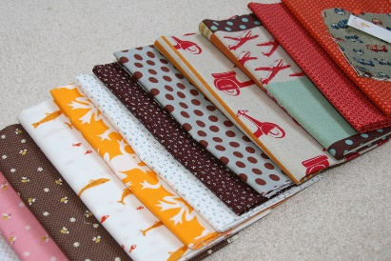
Personal Protective equipment
Complete sourcing solutions & Trade deals
Furniture
Shark Tower, 3rd floor
29, Nguyen Van Mai Street, Ward 8
District 3
Ho Chi Minh City
Vietnam
Tel : +84933296202
Tel : +94776331147 Whatsapp/viber
Email : Marguerite.Aluwihare@net-glo.com
Consumer products

Slide 2
Shark Tower, 3rd floor
29, Nguyen Van Mai Street, Ward 8
District 3
Ho Chi Minh City
Vietnam
Tel : +84933296202
Tel : +94776331147 Whatsapp/viber

Slide 3
Website : www.Net-Glo.com
Business : Global Networking, International sourcing
solutions, Management consultancy, trade deals
Location : Strategically located in Vietnam with offices in Ho Chi Minh city
and Hanoi and liaison partners in strategic locations :Thailand, Singapore,
Malaysia, Indonesia, China, Cambodia & Sri Lanka and adding Africa and
The Philippines soon.
Liaison partners :
Our liaison partners in these locations have been handpicked as they count years of experience in negotiations, are leaders
of business & industry, have lead Chambers of Commerce, business councils and count years of experience within their
scope of business.
Australia –
In partnership with Navam Enterprise,
Mr. Panjan Navaratnam
Tel : +61 469049451
Email : panjan.navam@gmail.com

